Slide 1
1. Introduction
Online E-waste Collection System (OECS) is used for the collection of the electronic waste material from the customer, local collector, so on. The customer can define the details about which type of waste is having. The customer can get the money by giving the waste material. Online E-waste Collection System is for deplorers and recycling it in the company.
The main purpose of online e-waste collection system is to provide another way for the customer to giving the e-waste material. The E-waste collection system is an Internet based application that can be accessed throughout the Net and can be accessed by anyone who has a net connection
The goals of the system are:
To provide anytime anyplace service for the customer.
To reuse electronic waste material by recycling or deploy.
To decrease the electronic waste material from household.
To obtain statistic information about the problems effect by the e-waste material.
To provide awareness about electrical and electronic material using for household.

Slide 2
Problem Statement
Electronic waste(e-waste) is one of the fastest growing pollution problem world wide given the presence if a variety of toxic substance which can contaminate the environment and threatened human health, if disposal protocol are not meticulously managed.

Slide 3
Objectives
The major purpose of project is to build capacity of practitioners and decision makers to
guide and handhold them to plan, design and implement Online WEEE/E-waste
Collection System including policy, collection, transportation and treatment in a city/
geographical area and country.
Encourage and promote the development and progress of Online E-waste Collection
System towards achieving in the field of computer sciences and technology for Theater
applications both for recycling and deployment of electronic waste.

Slide 4
Proposed Method
To overcome this problem we are proposing this online e waste collection system which is used for collection of electronic waste materials from customer, local collectors, so on. The customer can define about which type of waste having. The customer can get money by giving their e waste materials. This system is for deplorers and recycling it in the company.

Slide 5
Scope
The scope of the project is to provide approaches and strategies which have proved to be the suitable when assessing the e-waste system of the defined region.
This collection will reduce the e-waste from the household, company, industries, city, etc. The Environment pollution will reduce and the electronic waste will recycle or deployed.
This technique could eliminate waste disposal costs, reduce raw material costs and provide income from a salable waste. Waste can be recovered on-site, or at an off-site recovery facility, or through inter industry exchange

Slide 6
Feasibility Study
Whenever we design a new system, normally the management will ask for a feasibility report of the new system. The arrangement wants to know the technicalities and cost involved in creation of new system.
Technical feasibility
Technical feasibility involves Collection of E-waste Collection to establish the technical capability of the system being created to accomplish all requirements to the user. The system should be capable of handling the proposed volume of data and provide users and operating environment to increase their efficiency. For example,system should be capable of handling the proposed volume of data and provide users.
Economic feasibility
Economic feasibility involves E-waste Collection to establish the cost benefit
analysis. Money spent on the system must be recorded in the form of benefit .

Slide 7
Functional Requirement
Customer
Home Page :- It is index page of application from where user can navigate to other pages and he can also see posts.
Customer Login:- Registered user will login and then he is able to make deals for e-wastes.
Customer Signup:- Registration of user will be done by this function.
Post for Sale:- Customer will make a post for selling his product.
Your Posts:- Customer can view his products posts and sold status.
Manage Account:-User can update ,view details ,logout and delete account.
Buying Request:- Customer see Buying requests for products.
Feedback:-Customer can give feedback to our platform.
Company
Home Page:-In this page recently posted e waste products are shown and Company can navigate to other functions from this page.
Company Signup:-Registration of Company is done by this function.
Company Login:-Company will Login by this function.
Remaining Collections:- company can see no. of e-wastes collections remaining .
Received Product:- Employee can see collected e-waste products.
Buy Products:- company can make buy request to the customer by this function.
Manage Account:-User can update ,view details ,logout and delete account.
Feedback:-Companies can give feedback to our platform.
Admin
Manage customer:- Admin can manage Customers .
Manage Companies:-Admin can manage companies who buys products from customers.

Slide 8
Non-Functional requirements:-
User authentication(verify user by One time Password System during signup)
Maintaining session(during user login)
Responsive User Interface (So that the application automatically adjust its elements with screen size).
Form Validations(So that nobody can enter wrong data).
Security(Validation on server site).
Optimization(in this less execution time and greater memory efficiency).

Slide 9
Requirements
Front End & Back End
Front End Tools :
HTML5,
CSS,
JavaScript,
Java
Back End Tools :
MYSQL
Hardware Requirement
Client Side:
Windows XP, Win7, Win8
RAM 512 MB
Hard disk 1 GB
Processor 1.0 GHz
Server Side:
Windows XP, Win7, Win8
RAM 1 GB
Hard disk 3 GB
Processor 2.0 GHz
Software Requirement
Client Side:
Web Browser IE, IE8, Mozilla Firefox, Chrome, Opera
Operating System Windows, Mac OS, Linux
Server Side:
Tomcat
MySQL
Web Brower IE, IE8, Mozilla Firefox, Chrome, Opera etc.
Operating System Window Server 2007

Slide 10
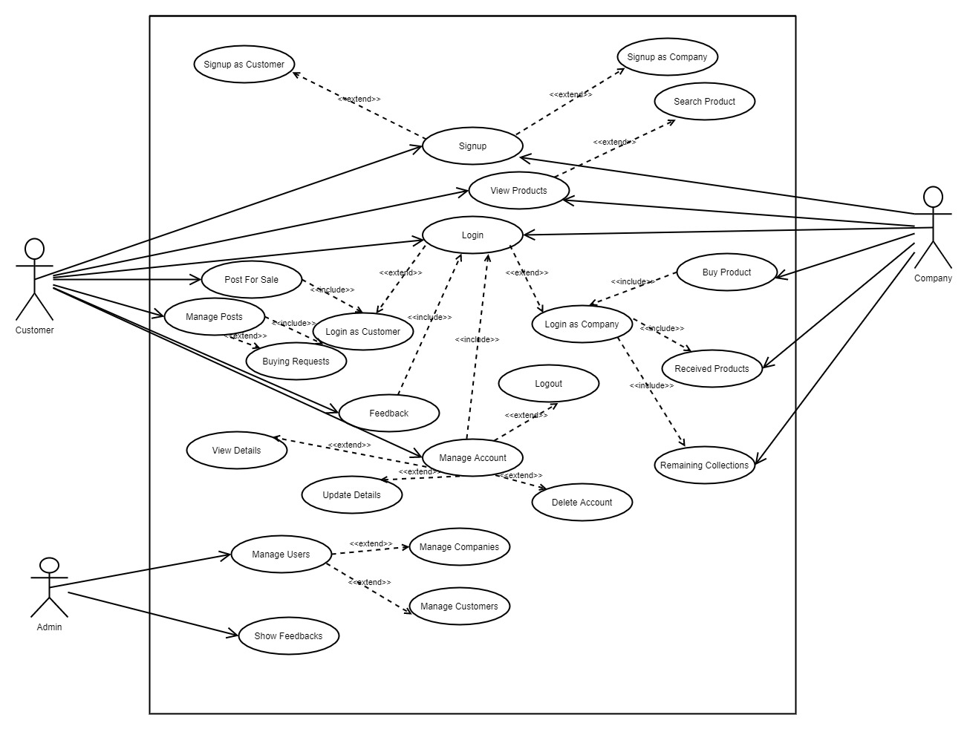
Use Case Diagram

Slide 11
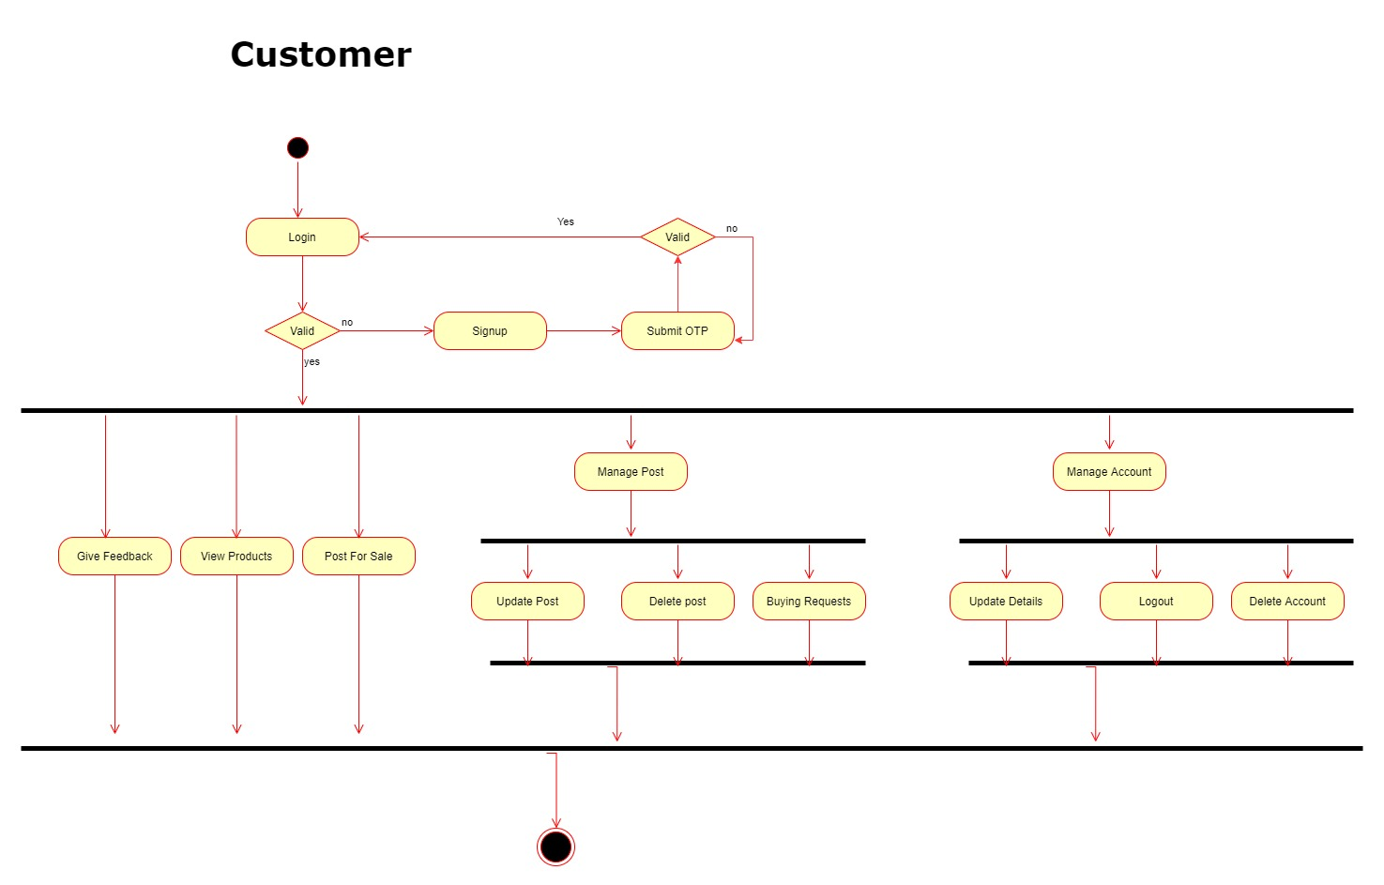
Activity Diagram

Slide 12
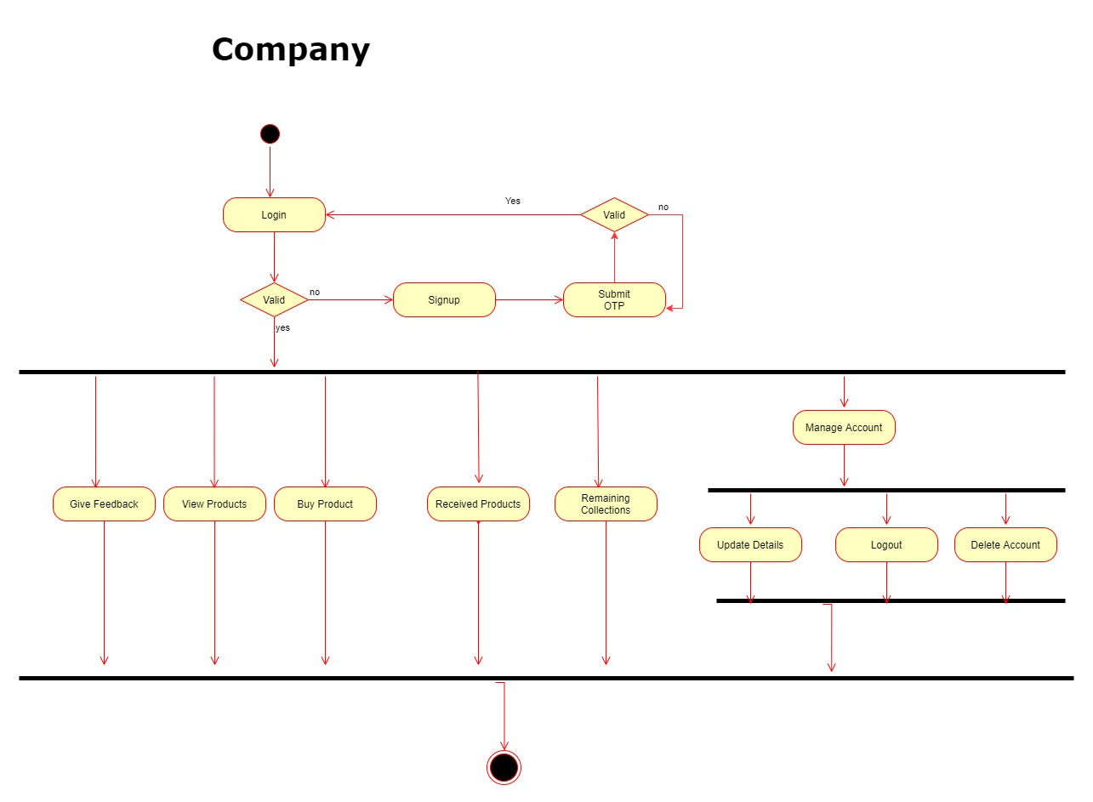

Slide 13
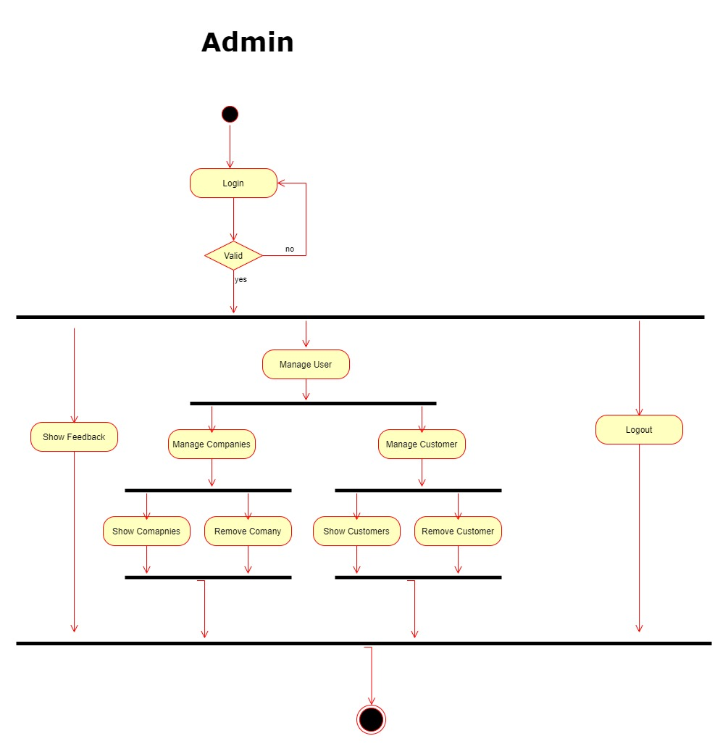

Slide 14
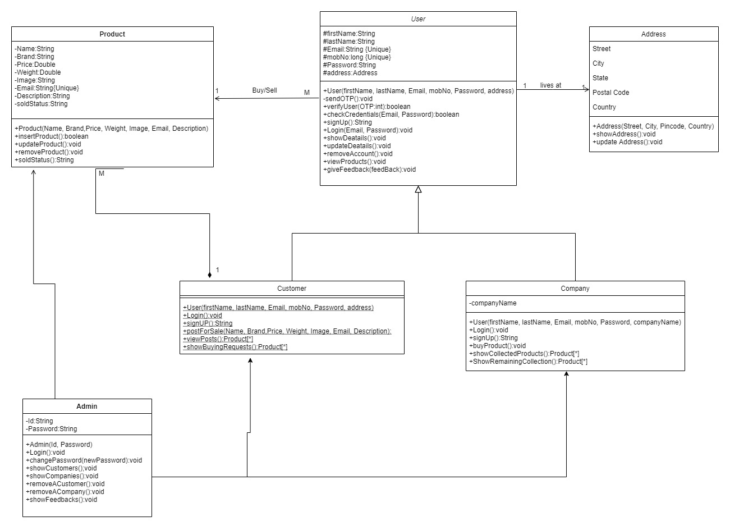
Class Diagram

Slide 15
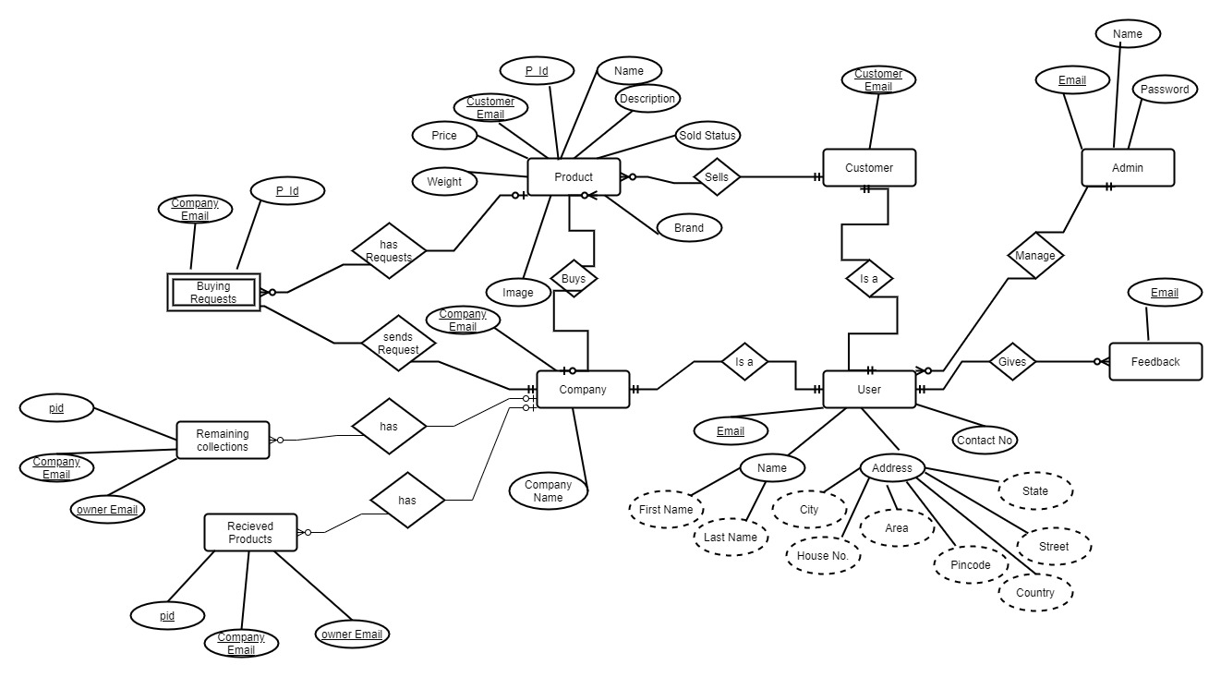
ER- Diagram

Slide 16
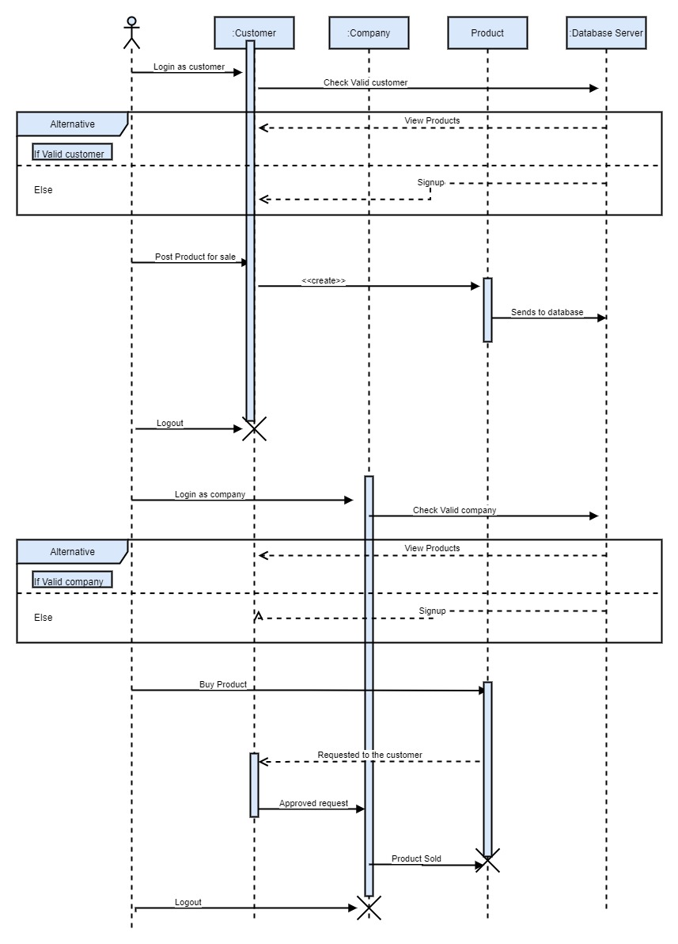
Sequence Diagram

Slide 17
Limitations of the Work
Setting up new recycling unit involves high cost. Recycling is not always cost-effective.
Sometimes, there may be a need to establish separate factories to process reusable
products. This may create more pollution as they would go under the process of cleaning,
storage and transportation.
Recycled products are always not of durable quality. Such items are mostly made of
trashed waste, picked up from heaps other waste products which are of fragile or overly
used. For this reason, recycled products are cheap and last for a shorter period. Recycling
sites are often unsafe and unhygienic.
This not only causes widespread pollution but is harmful for dedicated people who
recycle such products. Long-term effects on environment is still unknown. So increasing
the education about the e-waste is needed

Slide 18
Future Scope:
• Setting up new recycling unit involves high cost. Recycling is not always cost-effective. Sometimes, there may be a need to establish separate factories to process reusable products. This may create more pollution as they would go under the process of cleaning, storage and transportation.
• Recycled products are always not of durable quality. Such items are mostly made of trashed waste, picked up from heaps other waste products which are of fragile or overly used. For this reason, recycled products are cheap and last for a shorter period. Recycling sites are often unsafe and unhygienic.
• This not only causes widespread pollution but is harmful for dedicated people who recycle such products. Long-term effects on environment is still unknown. so increasing the education about the e-waste is needed
•Could the sustainable cities of the future prominently feature e-waste collection? E-waste Collection System is future to reduce the electronic waste and reusability of the electronic material in future.

Slide 19
References
• https://www.teriin.org/article/e-waste-management-india-challenges-and-opportunities
• http://wiki.org/e-waste-system/
• http://zerowaste.com/
• http://e-wasterecycling.com/
• http://wasterecycle.org

Slide 20
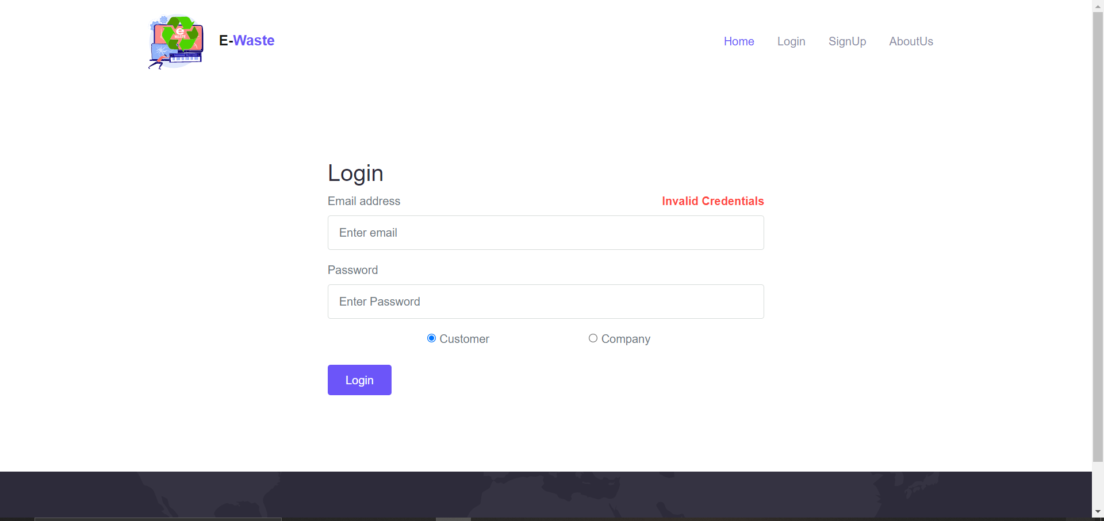
Project Snapshots
User Login with wrong details

Slide 21
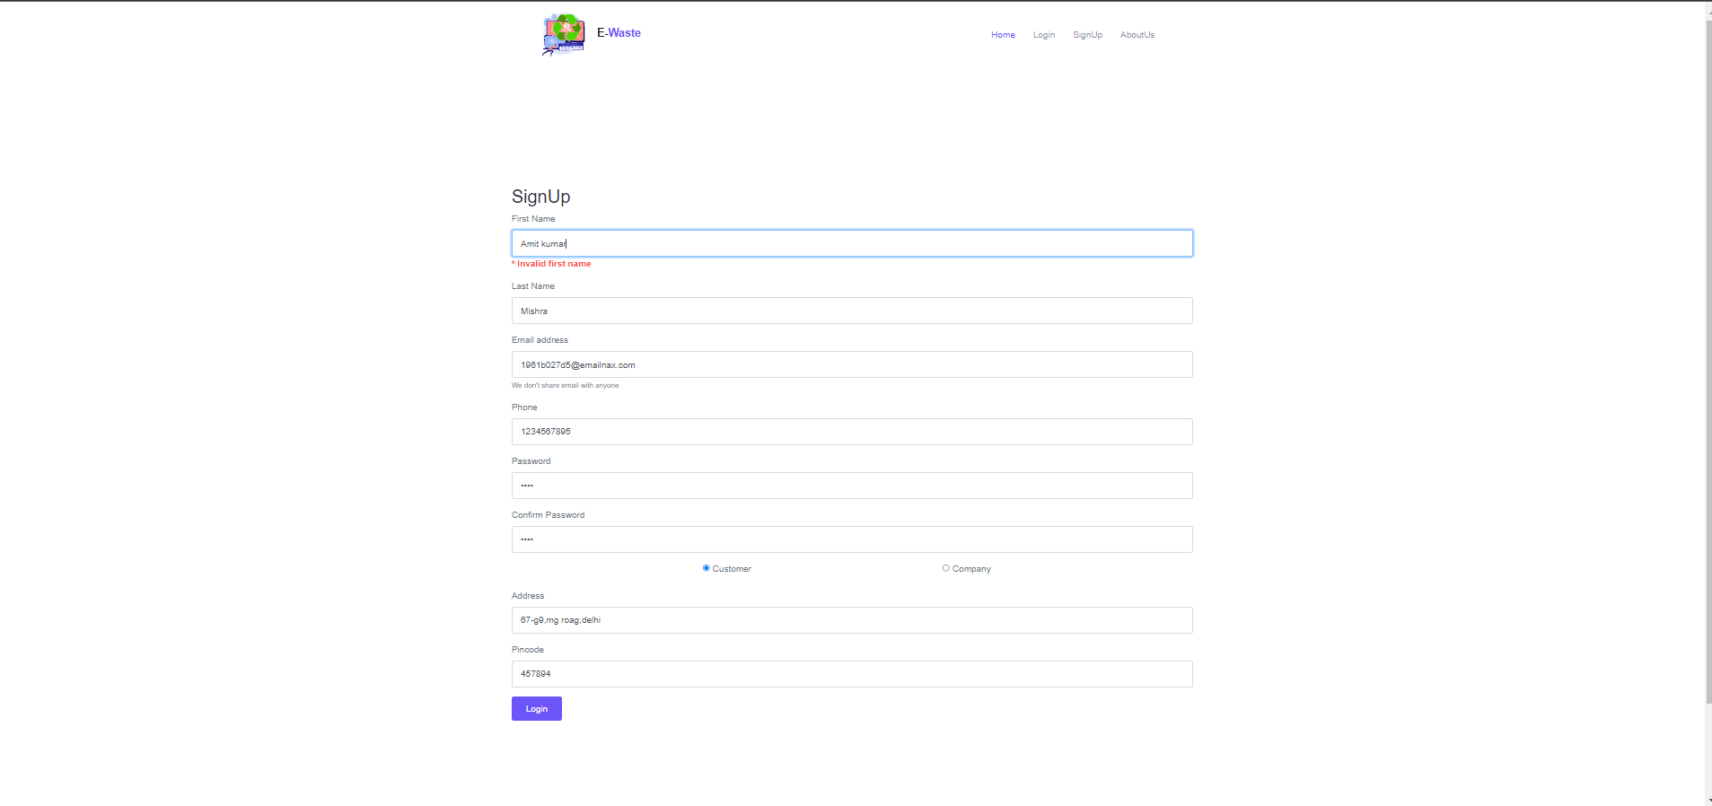
Customer Signup

Slide 22
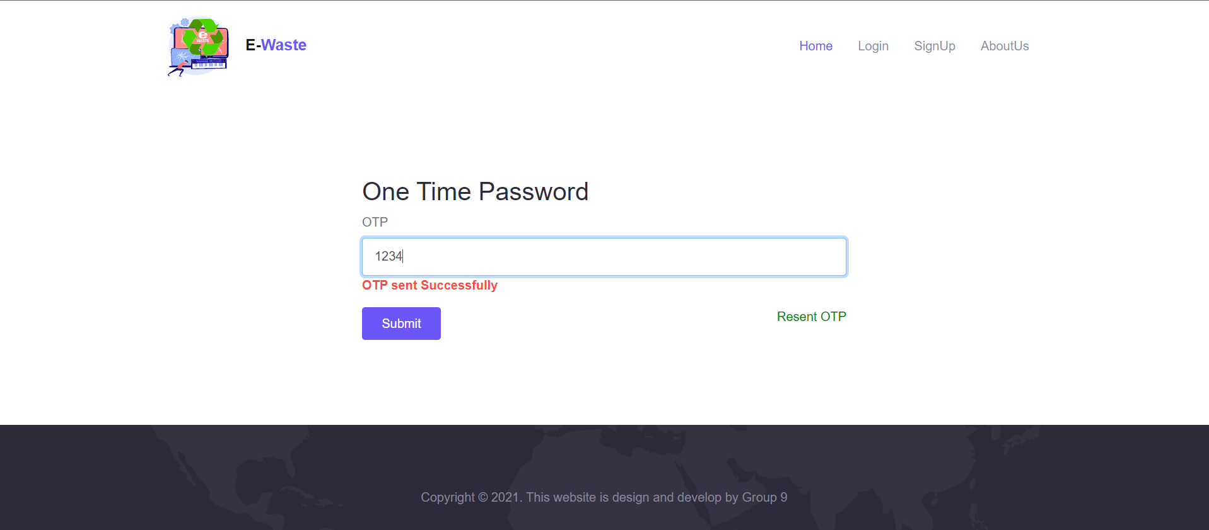
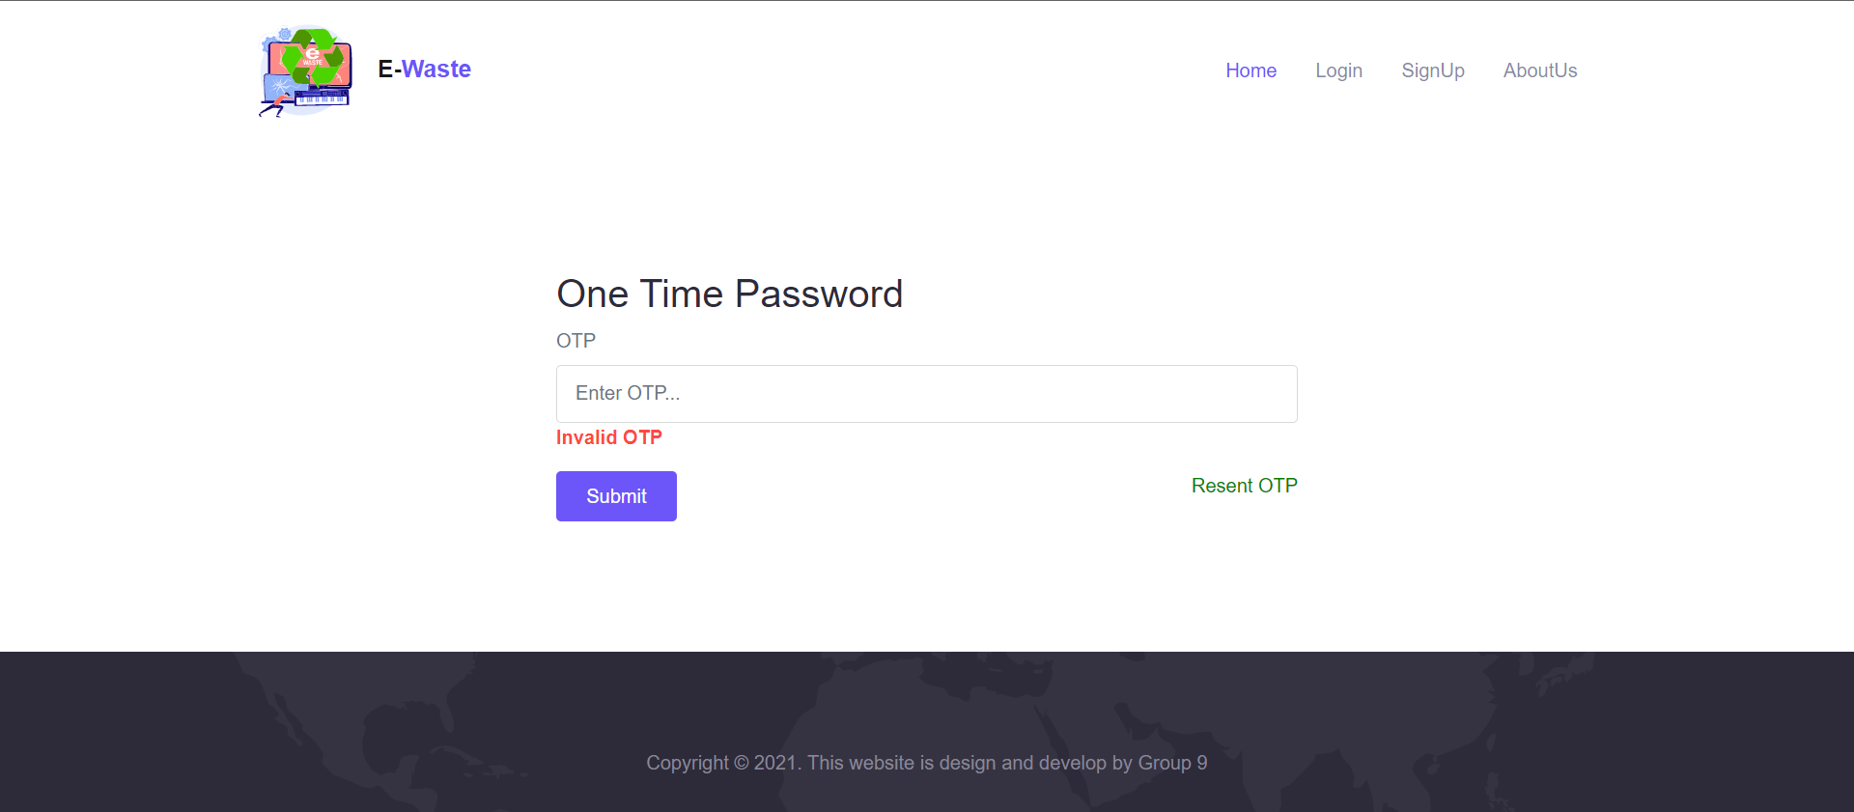
User Verification by OTP

Slide 23
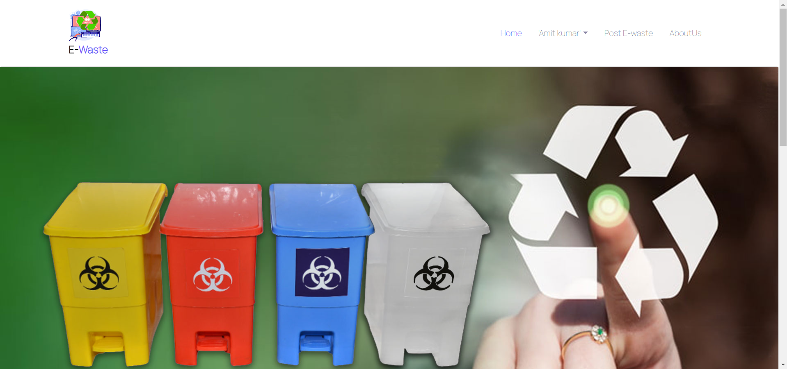
Customer Home

Slide 24
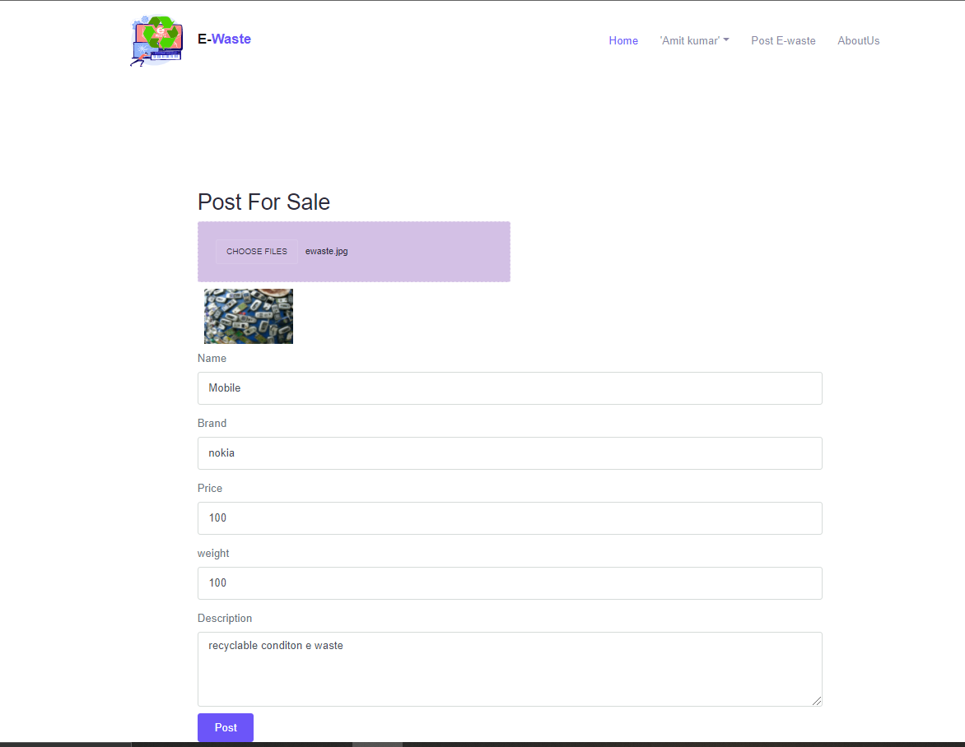
Post E-Waste

Slide 25
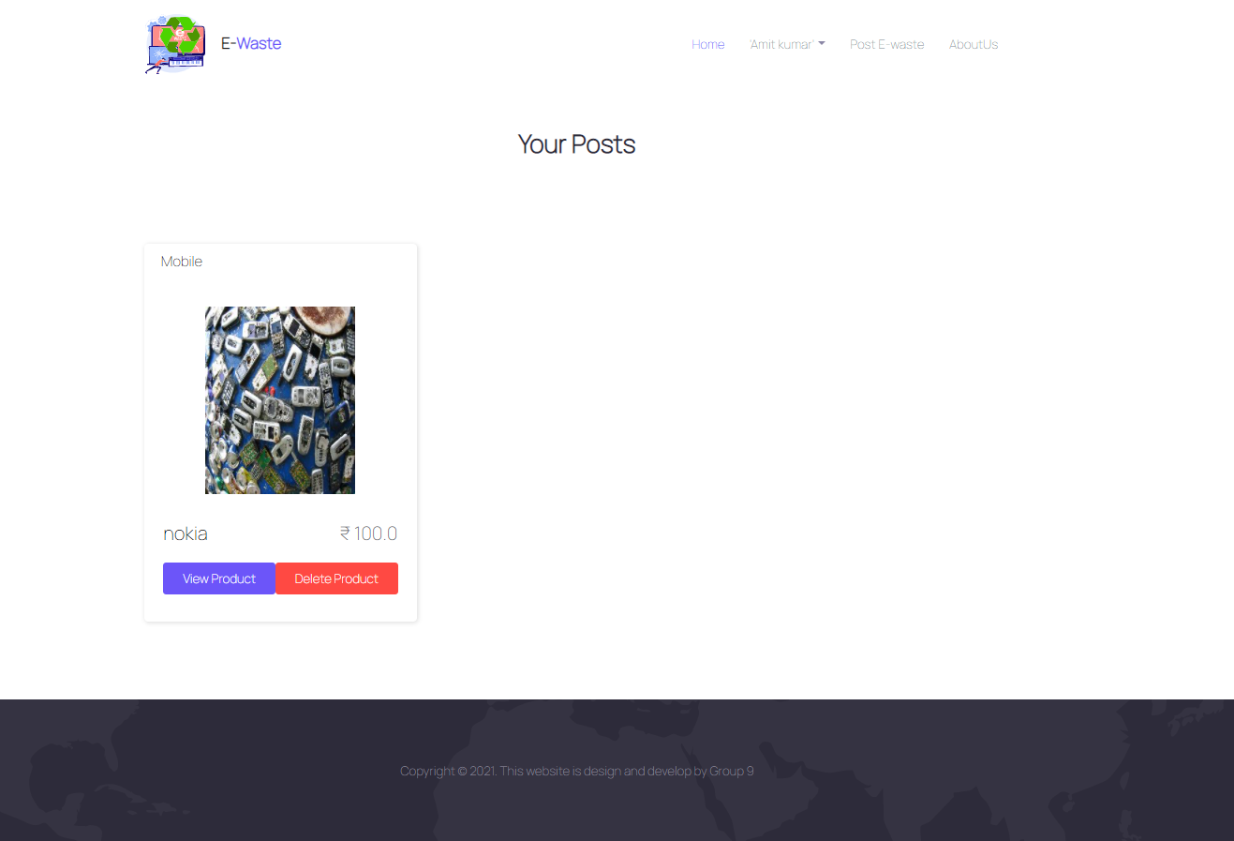
Customer Posts

Slide 26
Company Signup

Slide 27
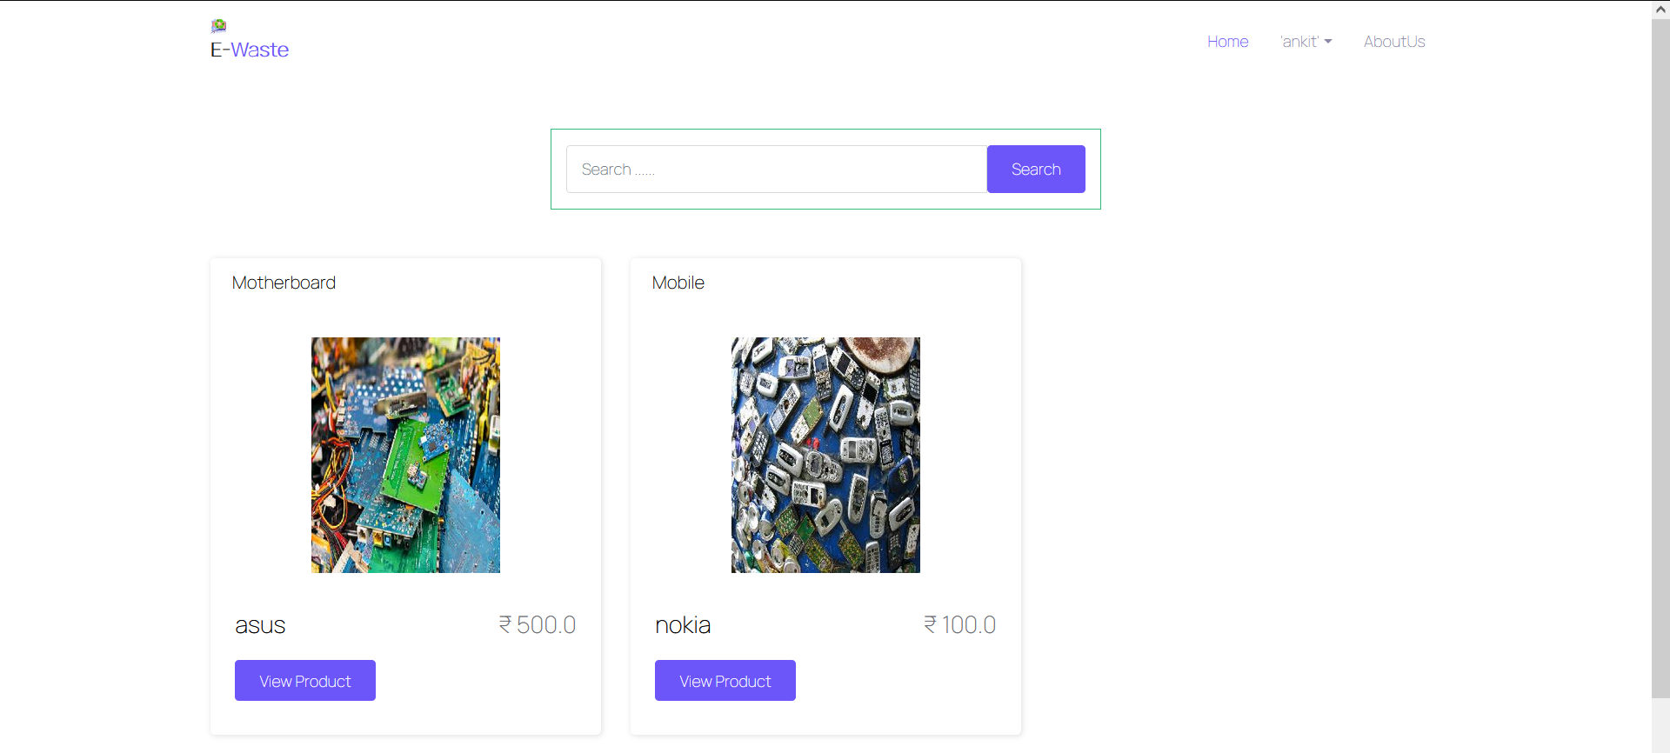
Company Home

Slide 28
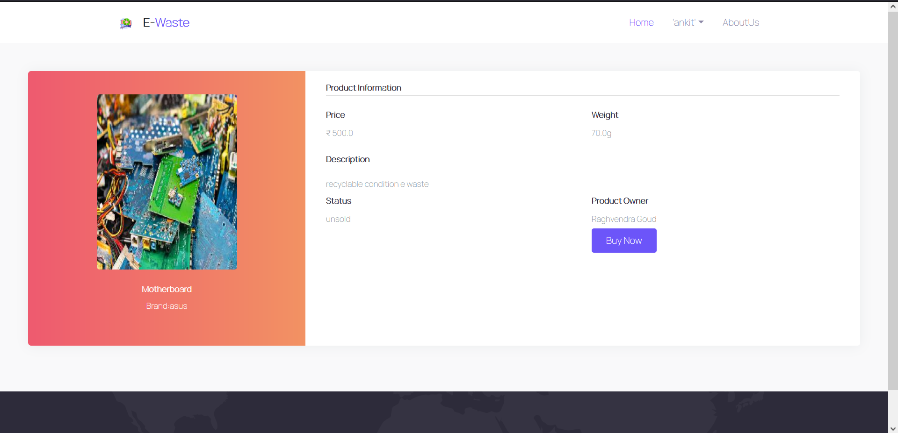
Company View Product

Slide 29
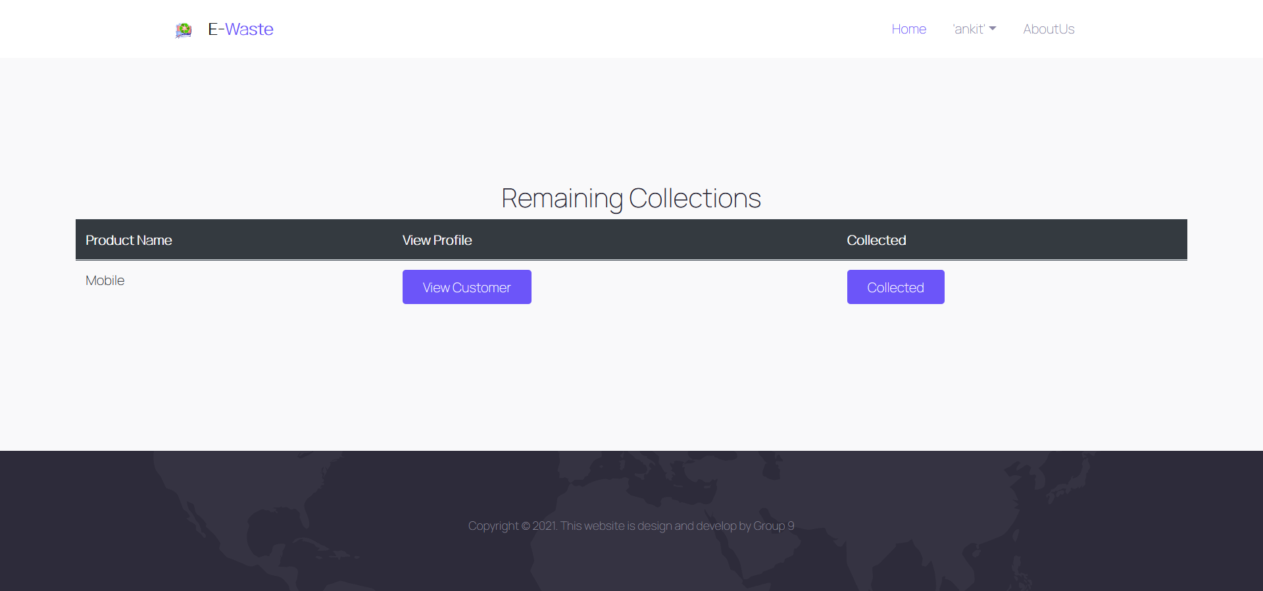
Company Remainig Collections

Slide 30
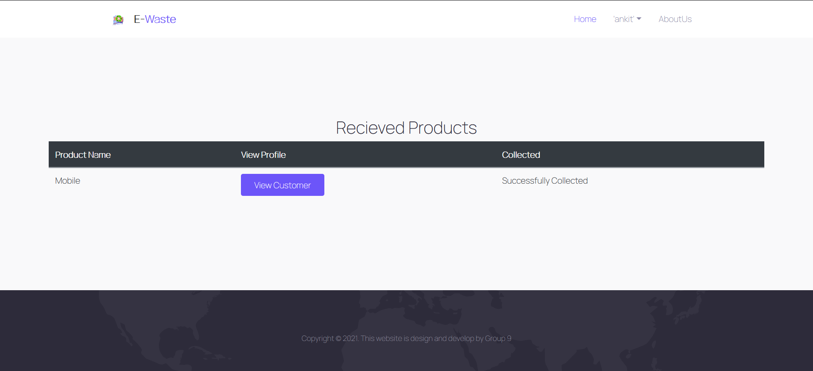
Company Received Products

Slide 31
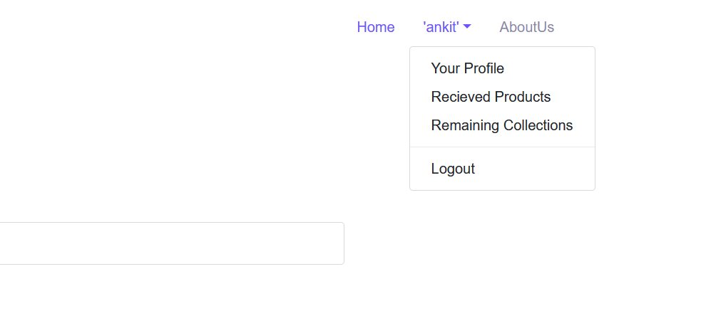
User Logout Option

Slide 32
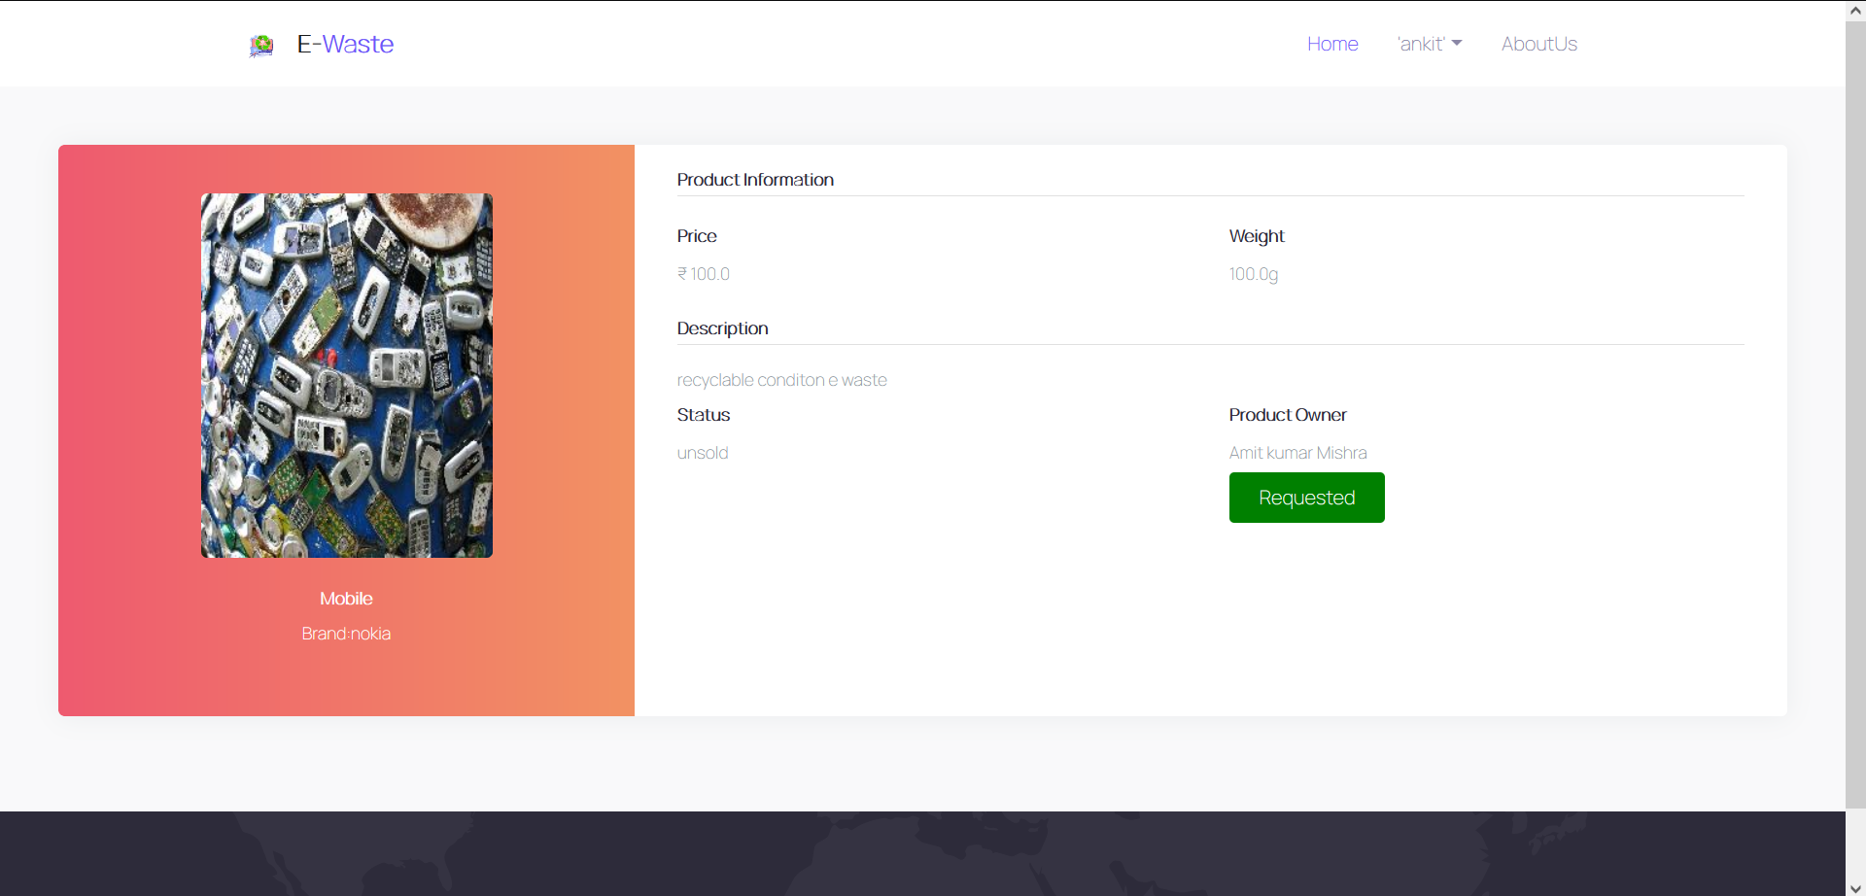
Company Made request

